Slide 1
ECU HARNESS AND ENGINE HARNESS FAILURE

Slide 2
EFFECTS OF FAILED ENGINE OR ECU HARNESS
Biggest effect of engine harness failure is ECU failure.
Sensor failure.
FIRE incidents.
Breakdown of ST, Low Pick-up, mis-firing.
Driver complaints of ST, Low Pick-up, mis-firing.

Slide 3
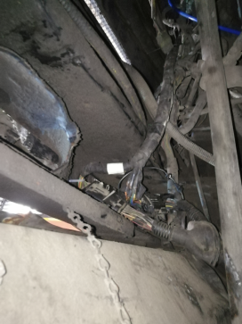
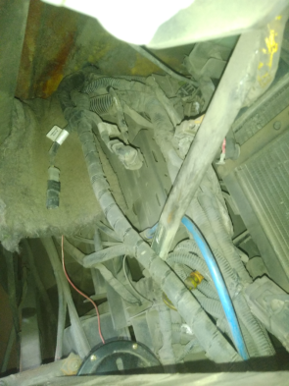
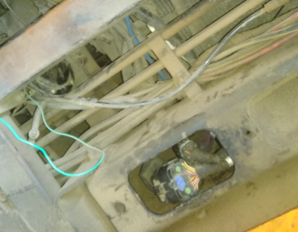
unmounted end connectors
Hanging harness
Loosed harness
BEFORE ECU HARNESS END CONNECTOR
BEFORE ECU HARNESS
THE BIGGEST CAUSE OF HARNESS FAILURE IS DUE TO HARNESS FOULING WITH SHARP EDGES OF BODY NEAR TO INSTRUMENT CLUSTER.
CAUSES OF ECU HARNESS FAILURE

Slide 4
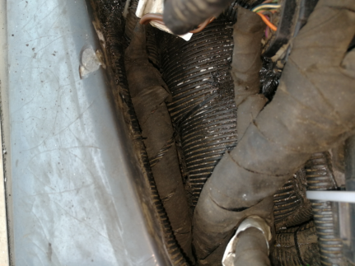
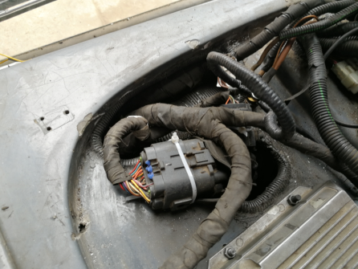
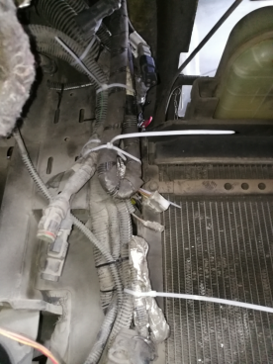
MAIN CAUSE OF FAILURE BEHIND ECU HARNESS IS NOW COVERED WITH COMBINATION OF PROTECTIVE SLEEVE AND SILION SEALENT
Properly mounted end connectors
AFTER ECU HARNESS END CONNECTOR
Properly mounted harness
AFTER ECU HARNESS

Slide 5
ROUTING OF ENGINE HARNESS HAS CHANGED.
RATHER THAN PASSING THROUGH AIR COMPRESSOR VIA CHASSIS CROSS MEMBER AND THEN GETS CONNECTED WITH ECU HARNESS NEAR TO RADIATOR BOTTOM, NOW ITS REROUTED AND GETS DIRECTLY INSIDE INSTRUMENT CLUSTER FROM ENGINE.
THUS MAKE IT MORE SAFE FROM HEATING AND FOULING ISSUES.
ALSO ITS ECU HARNESS CONNECTED SIDE ‘CONNECTOR’ IS SAVED FROM UNNECESSARY CORROSION, DUE TO DUST AND WATER WHICH GETS IN DIRECT CONTACT DURING WASHING, RAINING AND IN RUNNING CONDITIONS.

Slide 6
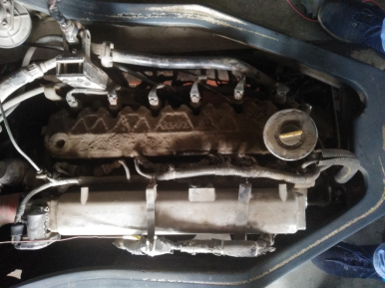
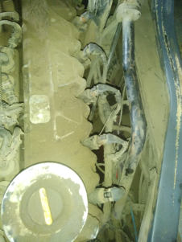
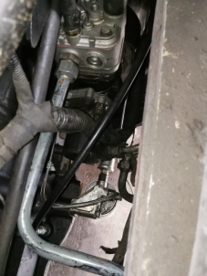
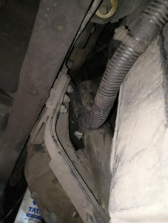
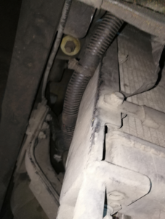
CAUSE OF FAILURE WITH ENGINE HARNESS
UNMOUNTED ENGINE HARNESS FOULES WITH NEARBY COMPONENTS WHICH RESULTS IN PREMATURE FAILURES DUE TO FRICTION AND CUTTING ACTION BETWEEN TWO SURFACES, MELTING OF HARNESS DUE TO EXCESSIVE HEAT OF AIR COMPRESSOR OUTLET PIPE OR EXHAUST HEAT.
HARNESS FOULING WITH AIR COMPRESSOR PIPE
HARNESS FOULING WITH CROSS MEMBER
HARNESS FOULING WITH GEAR LEVER
HARNESS FOULING WITH RADIATOR

Slide 7
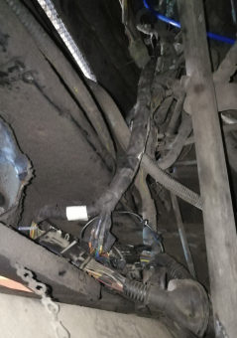
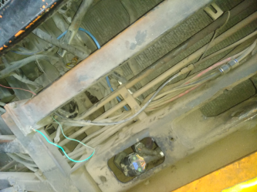
BEFORE ENGINE HARNESS POSITION
ENGINE HARNESS END CONNECTOR

Slide 8
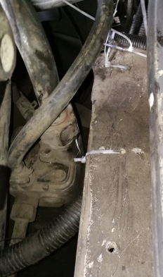
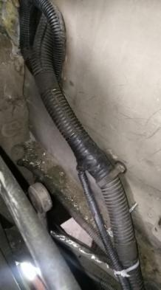
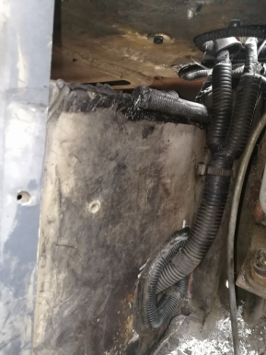
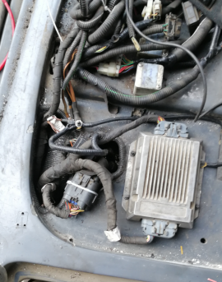
AFTER ENGINE HARNESS POSITION
ENGINE HARNESS END CONNECTOR
END CONNECTOR ARE SECURED INSIDE INSTRUMENT CLUSTER THUS MAKING IT MORE SAFE FROM HEAT, DUST AND RAIN WATER.

Slide 9
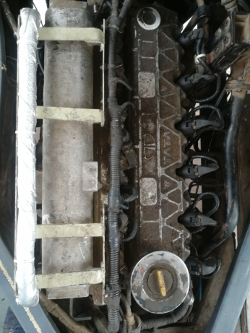
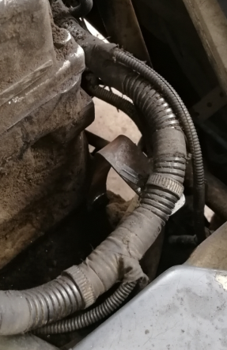
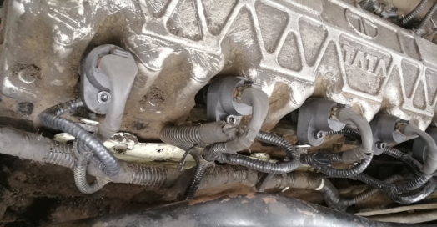
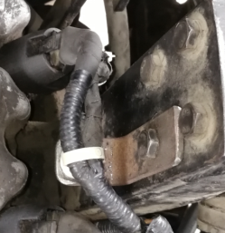
NEWLY DEVELOPED HARNESS MOUNTED BRACKETS
MODIFIED HARNESS MOUNTED BRACKETS

Slide 10
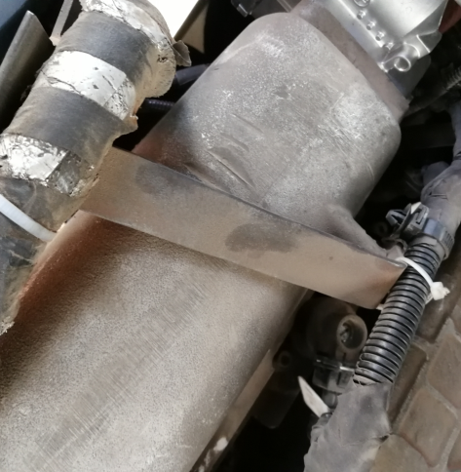

OLDER BRACKET IS MADE OF TWO PIECES AND ONCE ANY PIECE GETS LOOSENED, IT DAMAGES INTAKE MANIFOLD.
NEWLY MODIFIED BRACKET IS MADE OF SINGLE PIECE ONLY AND THUS, DOESN’T DAMAGE INTAKE MANIFOLD EVEN WHEN GETS LOOSED AND ALSO ALLOWS TO MOUNT ENGINE HARNESS AND ALSO MAKES CNG INJECTORS REMOVAL VERY EASY, AS REMOVAL OF WHOLE BRACKET IS NOT REQUIRED.

Slide 11
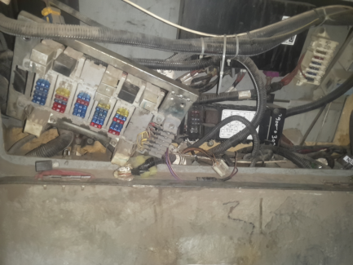
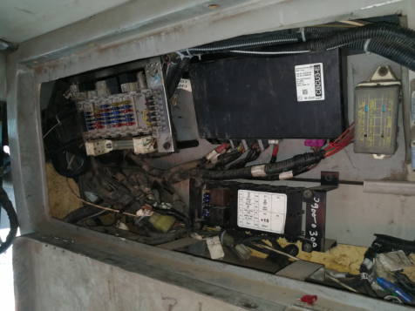
BEFORE
AFTER
FUSE BOX HANGING, LOSSED AND EXTRA WIRES ATTACHED
FUSE BOX MOUNTED PROPERLY, ALL WIRING HARNESS MOUNTED PROPERLY AND EXTRA WIRES REMOVED

Slide 12
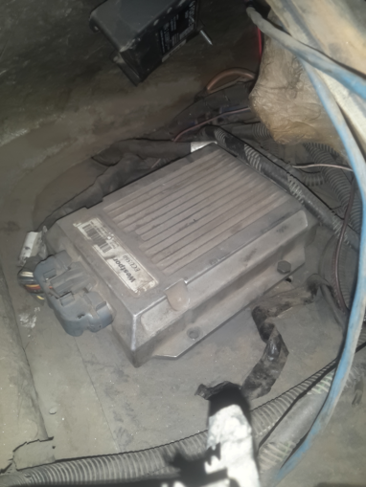
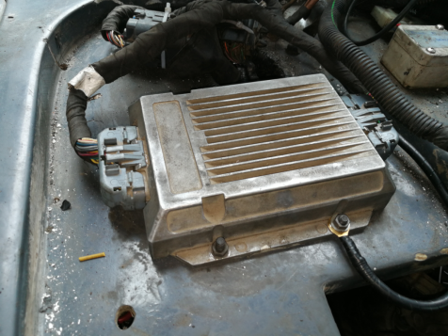
BEFORE
AFTER
PROPERLY MOUNTED ECU WITH NEWLY DRILLED HOLES AND IS REPOSITIONED.
ALSO EXTRA EARTHING IS PROVIDED FOR MORE SAFETY TO ECU.
LOOSED ECU AND MOUNTING HOLES ARE DAMAGED

Slide 13
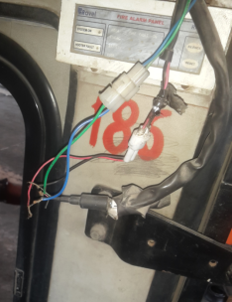
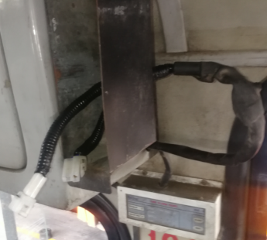
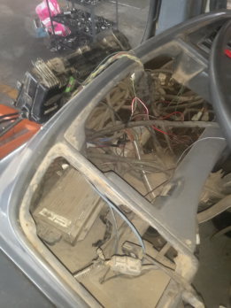
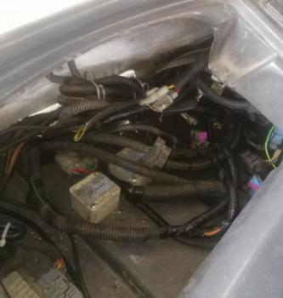
ALL WIRING HARNESS IS SORTED CAREFULLY AND ALSO TEMPORARY OR NAKED WIRES ARE REMOVED AND PROPER INSULATION AND PROTECTION IS PROVIDED TO COMPLETE INSTURMENT CLUSTER HARNESS.
BEFORE
AFTER

Slide 14
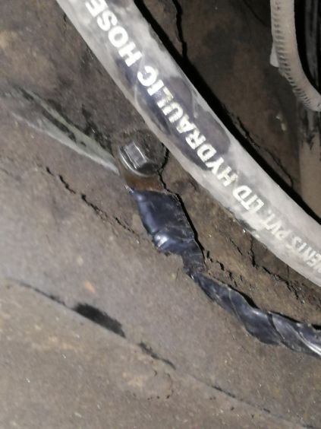
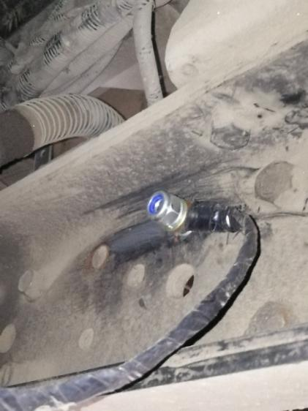
EXTRA EARTHING POINT IS PROVIDED AND IS CONNECTED BETWEEN ENGINE AND CHASSIS.

Slide 15
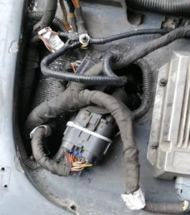
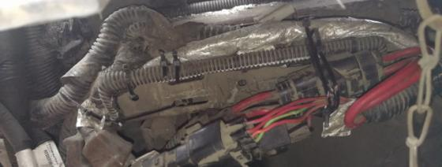
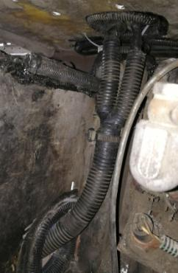
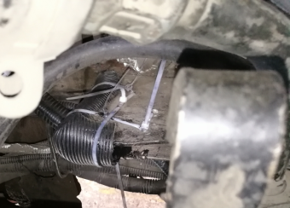
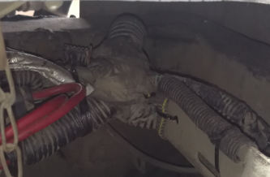
EXTRA PROTECTION IS PROVIDED USING COMBINATION OF SILICON SEALENT AND PROTECTED SLEEVE.

Slide 16
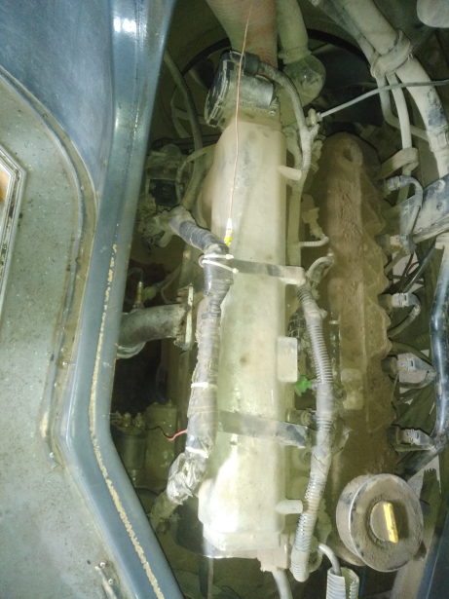
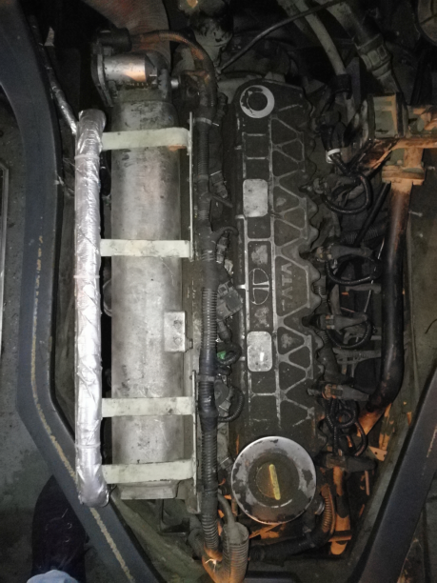
ALTERNATOR AND SELF STARTER HARNESS
BEFORE
AFTER

